Slide 1
Power and Sample Size Determination
CHAPTER 8

Slide 2
Learning Objectives
Provide examples demonstrating how the margin of error, effect size, and variability of the outcome affect sample size computations
Compute the sample size required to estimate population parameters with precision
Interpret statistical power in tests of hypothesis
Compute the sample size required to ensure high power in tests of hypothesis

Slide 3
Sample Size Determination
Adequate sample size is needed to ensure precision in analysis.
Sample size determined based on type of planned analysis.
Confidence interval estimate
Test of hypothesis

Slide 4
Determining Sample Size for Confidence Interval Estimates (1 of 2)
Goal is to estimate an unknown parameter using a confidence interval estimate.
Plan a study to sample individuals, collect appropriate data and generate CI estimate.
How many individuals should we sample?

Slide 5
Determining Sample Size for Confidence Interval Estimates (2 of 2)
Confidence intervals
point estimate ± margin of error
Determine n to ensure small margin of error (precision).
Must specify desired margin of error, confidence level, and variability of parameter.

Slide 6
Example 8.1. Find n for One Sample, Continuous Outcome (1 of 2)
Planning study to estimate mean systolic blood pressure in children with congenital heart disease.
Want estimate within 5 units of true mean
Will use 95% confidence level; estimate of standard deviation is 20.

Slide 7
Example 8.1. Find n for One Sample, Continuous Outcome (2 of 2)
Need sample size of 62 children with congenital heart disease

Slide 8
Example 8.3. Find n for One Sample, Dichotomous Outcome (1 of 2)
Planning study to estimate proportion of freshmen who currently smoke
Want estimate within 5% of the true proportion; will use 95% confidence level

Slide 9
Example 8.3. Find n for One Sample, Dichotomous Outcome (2 of 2)
Formula requires estimate of proportion, p. If unknown, use p = 0.5 to produce largest n (most conservative).
Need sample size of 385 freshmen

Slide 10
Example 8.5. Find n for Two Independent Samples, Continuous Outcome (1 of 5)
Planning a study to assess the efficacy of a new drug to raise HDL cholesterol
Participants will be randomized to receive either the new drug or placebo and followed for 12 weeks.
Goal is to estimate the difference in mean HDL between groups (μ₁ – μ₂).

Slide 11
Example 8.5. Find n for Two Independent Samples, Continuous Outcome (2 of 5)
Want estimate of the difference to be no more than 3 units
We will use a 95% confidence interval.
The estimate of the (common) standard deviation in HDL is 17.1.
We expect 10% attrition over 12 weeks.

Slide 12
Example 8.5. Find n for Two Independent Samples, Continuous Outcome (3 of 5)
Need n₁ = 250 and n₂ = 250 with complete outcome data

Slide 13
Example 8.5. Find n for Two Independent Samples, Continuous Outcome (4 of 5)
Need n₁ = 250 and n₂ = 250 with complete outcome data (at end of study)
Need to account for 10% attrition
How many subjects must be enrolled?

Slide 14
Example 8.5. Find n for Two Independent Samples, Continuous Outcome (5 of 5)
Need n₁ = 250 and n₂ = 250 with complete outcome data
Account for 10% attrition:
N (to enroll)*(% retained) = 500
Need to enroll 500/0.90 = 556
Participants enrolled N = ?
90%
Complete study (500)
10%
Lost to follow-up

Slide 15
Example 8.7. Find n for Two Matched Samples, Continuous Outcome (1 of 5)
Planning study to estimate the mean difference in weight lost between two diets (low-fat versus low-carb) over 8 weeks
A crossover trial is planned where each participant follows each diet for 8 weeks and weight loss is measured.
Goal is to estimate the mean difference in weight lost (μ_{d}).

Slide 16
Example 8.7. Find n for Two Matched Samples, Continuous Outcome (2 of 5)
Need to specify the margin of error (E), decide on the confidence level, and estimate the variability in the difference in weight lost between diets

Slide 17
Example 8.7. Find n for Two Matched Samples, Continuous Outcome (3 of 5)
Want estimate of the difference in weight lost to be within 3 pounds of the true difference
We will use a 95% confidence interval.
The standard deviation of the difference in weight lost is estimated at 9.1.
Expect 30% attrition over 16 weeks.

Slide 18
Example 8.7. Find n for Two Matched Samples, Continuous Outcome (4 of 5)
Need n = 36 with complete outcome data

Slide 19
Example 8.7. Find n for Two Matched Samples, Continuous Outcome (5 of 5)
Need n = 36 with complete outcome data
Account for 30% attrition:
N (to enroll)*(% retained) = 36
Need to enroll 36/0.70 = 52
Participants enrolled N = ?
70%
Complete study (36)
30%
Lost to follow-up

Slide 20
Example 8.8. Find n for Two Independent Samples, Dichotomous Outcome (1 of 2)
Planning study to estimate the difference in proportions of premature deliveries in mothers who smoke compared to those who do not
Want estimate within 4% of the true difference, will use 95% confidence level and assume that 12% of infants are born prematurely

Slide 21
Example 8.8. Find n for Two Independent Samples, Dichotomous Outcome (1 of 2)
Need n₁ = 508 women who smoke during pregnancy and n₂ = 508 who do not, with complete outcome data

Slide 22
Determining Sample Size for Hypothesis Testing (1 of 2)
α = P(Type I error) = P(Reject H₀|H₀ true)
β = P(Type II error)
= P(Do not reject H₀|H₀ false)
Power = 1 – β = P(Reject H₀|H₀ false)

Slide 23
Determining Sample Size for Hypothesis Testing (2 of 2)
β and power are related to the sample size, level of significance (α), and the effect size (difference in parameter of interest under H₀ versus H₁).

Slide 24
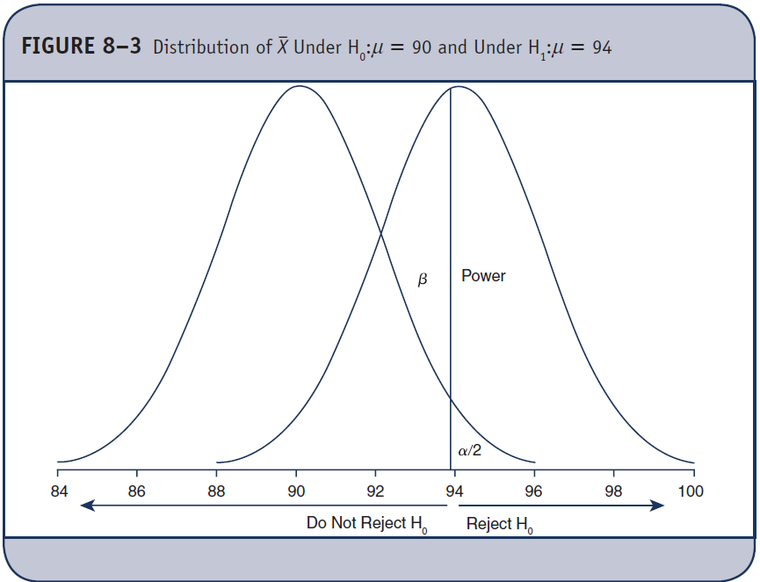
α, β, and Power

Slide 25
Determining Sample Size for Hypothesis Testing
β and power are related to the sample size, level of significance (α), and the effect size (difference in parameter of interest under H₀ versus H₁).
Power is higher with larger α.
Power is higher with larger effect size.
Power is higher with larger sample size.

Slide 26
Example 8.11. Find n to Test H₀: μ = μ₀ (1 of 2)
Planning study to test
H₀: μ = $3302 vs.
H₁: μ ≠ $3302 at α = 0.05
Determine n to ensure 80% power to detect a difference of $150 in mean expenditures on health care and prescription drugs (assume standard deviation is $890).

Slide 27
Example 8.11. Find n to Test H₀: μ = μ₀ (2 of 2)
Need sample size of 272

Slide 28
Example 8.12. Find n to Test H₀: p = p₀ (1 of 2)
Planning study to test
H₀: p = 0.26 vs.
H₁: p ≠ 0.26 at α = 0.05
Determine n to ensure 90% power to detect a difference of 5% in the proportion of patients with elevated LDL cholesterol.

Slide 29
Example 8.12. Find n to Test H₀: p = p₀ (2 of 2)
Need sample size of 869

Slide 30
Example 8.14. Find n₁, n₂ to Test H₀: μ₁ = μ₂ (1 of 2)
Planning study to test
H₀: μ₁ = μ₂ vs.
H₁: μ₁ ≠ μ₂ at α = 0.05
Determine n₁ and n₂ to ensure 80% power to detect a difference of 5 units in means (assume standard deviation is 19.0).
Expect 10% attrition.

Slide 31
Example 8.14. Find n₁, n₂ to Test H₀: μ₁ = μ₂ (2 of 2)
Need samples of size n₁ = 232 and n₂ = 232
Account for 10% attrition:
N (to enroll)*(% retained) = 464
Need to enroll 464/0.90 = 516

Slide 32
Example 8.16. Find n to Test H₀: m_{d} = 0 (1 of 2)
Planning study to test
H₀: μ_{d} = 0 vs.
H₁: μ_{d} ≠ 0 at α = 0.05
Determine n to ensure 80% power to detect a 3-pound difference between diets (assume standard deviation of differences is 9.1).

Slide 33
Example 8.16. Find n to Test H₀: m_{d} = 0 (2 of 2)
Need sample of size n = 72

Slide 34
Example 8.18. Find n₁, n₂ to Test H₀: p₁ = p₂ (1 of 2)
Planning study to test
H₀: p₁ = p₂ vs.
H₁: p₁ ≠ p₂ at α = 0.05
Determine n₁ and n₂ to ensure 80% power to detect a difference in proportions of hypertensives on the order of 24% versus 30% in the new drug and placebo treatments.

Slide 35
Example 8.18. Find n₁, n₂ to Test H₀: p₁ = p₂ (2 of 2)
Need samples of size n₁ = 861 and n₂ = 861

